Slide 1
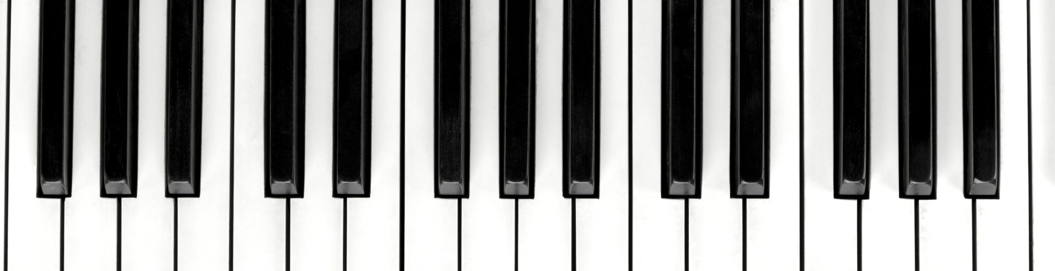

Music generation
Bidirectional RNNs and Markov Chains

Slide 2
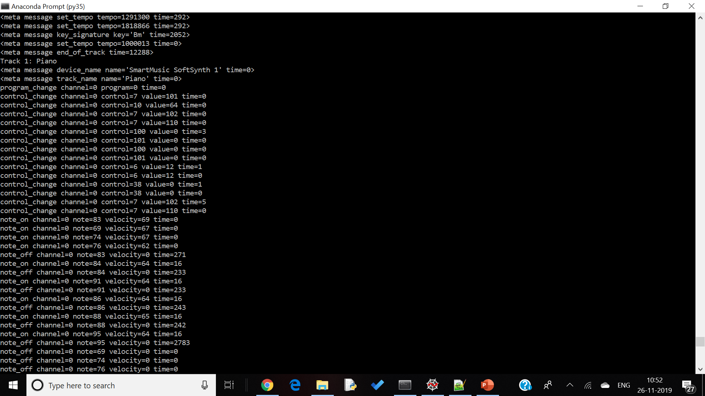
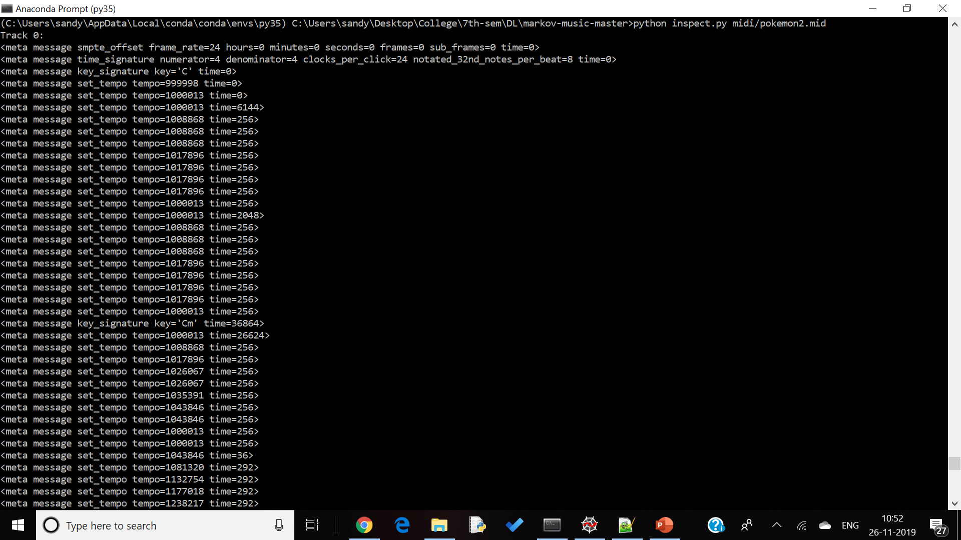
Dataset
Dataset consists of 307 MIDI files, containing background tracks from various Pokémon games.
MIDI files are simple files consisting of chunks which contain information about the music encoded in the file. An important distinction to note is that MIDI files are not audio files like MP3 files. Instead, they contain instructions on how to play tunes, which can be played by a variety of different computer-generated instruments. Because of this, they are limited in that they can only store a certain range of notes and cannot store complex audio like vocal lyrics.

Slide 3
Bidirectional RNN
By treating the notes and chords within MIDI files as discrete sequential data, we were able to train the model and use them to generate completely new MIDI files.
The model has 3 Bidirectional layers (stacked LSTM). Each layer has a forward and backward cell which parse the input in timesteps and produce an output tensor. The second layer has a dropout wrapper of drop-out probability 0.2. The dropout layer is a regularization technique that prevents overfitting by removing a proportion of neurons at random in every iteration. This forces the model to generalize remaining neurons by splitting the concepts learned among them. This is crucial for music generation as overfitting will cause the output to sound nearly identical to one or more of the original songs.
We chose the Softmax activation function on the outputs of the last layer. This predicts the most likely note that follows the sequence.

Slide 4
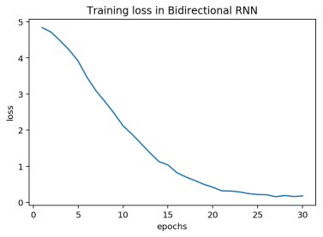
Results
Training loss observed over 30 epochs

Slide 5
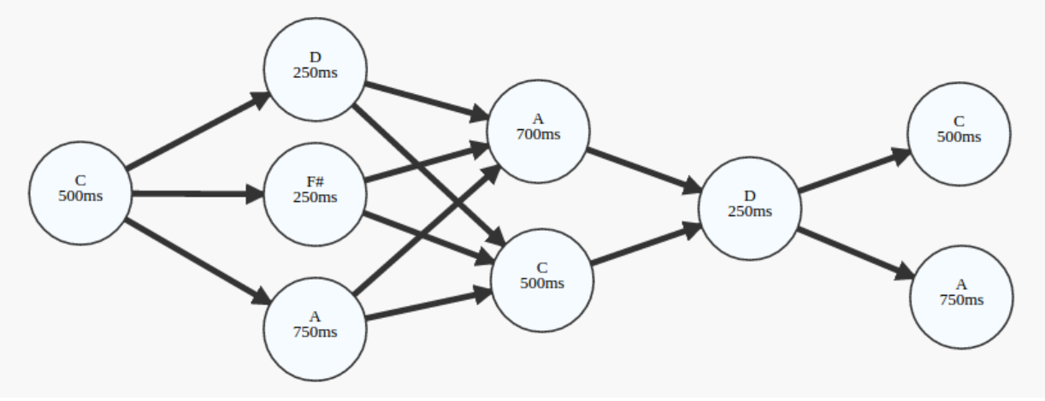
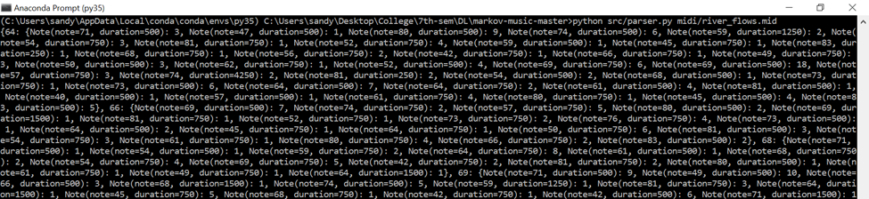
Markov Chains
To build the Markov Chain we group the notes which need to be played simultaneously into states and the transitions between the states denote the shift from one set of notes to another.
We used the note_on message information in each track to separate the notes into different states and build a dictionary structure which stores the number of transitions from one note to another.

Slide 6
Execution Environment
We used Google-Colab with a Python3-GPU runtime environment to the train the model.
Tensorflow, numpy, pandas and sklearn was used for the model
Music21 and mido was used for dataset preprocessing and generating the output MIDI files

Slide 7
Thank you

